Slide 1
The Executive Power Clause
The Stakes
and the Challenges of Sifting Through Evidence of the Meaning of a Historical Concept
Julian Davis Mortenson
University of Michigan

Slide 2
Can the U.S. President Break the Law?
“Any effort to apply [federal criminal law] in a manner that interferes with the President’s direction of … the detention and interrogation of enemy combatants thus would be illegal.”
– U.S. Department of Justice, Internal Memo on Legality of “Enhanced Interrogation” (2002)
Notes:
Torture
Wiretapping
Use of force

Slide 3
Art. I Legislative Power “Congress Shall Have Power…”
To lay and collect Taxes, Duties, Imposts and Excises, to pay the Debts and provide for the common defence and general Welfare of the United States; but all Duties, Imposts and Excises shall be uniform throughout the United States;
To borrow Money on the credit of the United States;
To regulate Commerce with foreign Nations, and among the several States, and with the Indian Tribes;
To establish an uniform Rule of Naturalization, and uniform Laws on the subject of Bankruptcies throughout the [US];
To coin Money, regulate the Value thereof, and of foreign Coin, and fix the Standard of Weights and Measures;
To provide for the Punishment of counterfeiting the Securities and current coin of the United States;
To establish Post Offices and post Roads;
To promote the Progress of Science and useful Arts, by securing for limited Times to Authors and Inventors the exclusive Right to their respective Writings and Discoveries;
To constitute Tribunals inferior to the Supreme Court;
To define and punish Piracies and Felonies committed on the high Seas, and Offenses against the Law of Nations;
To declare War, grant Letters of Marque and Reprisal, and make Rules concerning Captures on Land and Water;
To raise and support Armies, but no Appropriation of Money to that Use shall be for a longer Term than two Years;
To provide and maintain a Navy;
To make Rules for the Government and Regulation of the land and naval Forces;
To provide for calling forth the Militia to execute the Laws of the Union, suppress Insurrections and repel Invasions;
To provide for organizing, arming, and disciplining, the Militia, and for governing such Part of them as may be employed in the Service of the United States, reserving to the States respectively, the Appointment of the Officers, and the Authority of training the Militia according to the discipline prescribed by Congress;
To exercise exclusive Legislation in all Cases whatsoever, over such District (not exceeding ten Miles square) as may, by Cession of particular States, and the Acceptance of Congress, become the Seat of the Government of the United States, and to exercise like Authority over all Places purchased by the Consent of the Legislature of the State in which the Same shall be, for the Erection of Forts, Magazines, Arsenals, dock-Yards, and other needful Buildings;—And
To make all Laws which shall be necessary and proper for carrying into Execution the foregoing Powers, and all other Powers vested by this Constitution in the Government of the United States, or in any Department or Officer thereof.

Slide 4
Art II Presidential Power
The executive power shall be vested in a President of the United States of America
The President shall be commander in chief of army & navy
He may require the opinion, in writing, of the principal officer in each of the executive departments
He shall have power to grant reprieves and pardons
He shall have power, by and with the advice and consent of the Senate, to make treaties
He shall nominate, and by and with the advice and consent of the Senate, shall appoint ambassadors, . . . judges of the Supreme Court, and all other officers of the United States
He may, on extraordinary occasions, convene [or adjourn] both Houses [of Congress]…
He shall receive ambassadors and other public ministers
He shall take care that the laws be faithfully executed
Notes:
NOT INCLUDED: power to VETO (appears in Article I)
Note that almost all of these are PROCESS rights
informational rights: “opinion of officers”; “receive ambassadors”
COOPERATIVE process rights: participate in lawmaking; participate in appointments; participate in treatymaking --> each with a congressional check
only a couple of things seem genuinely independent [CLICK THROUGH]
Pardon power
Commander in chief
Take Care
The executive power

Slide 5
Art II Presidential Power
The executive power shall be vested in a President of the United States of America
The President shall be commander in chief of army & navy
He may require the opinion, in writing, of the principal officer in each of the executive departments
He shall have power to grant reprieves and pardons
He shall have power, by and with the advice and consent of the Senate, to make treaties
He shall nominate, and by and with the advice and consent of the Senate, shall appoint ambassadors, . . . judges of the Supreme Court, and all other officers of the United States
He may, on extraordinary occasions, convene [or adjourn] both Houses [of Congress]…
He shall receive ambassadors and other public ministers
He shall take care that the laws be faithfully executed
Notes:
NOT INCLUDED: power to VETO (appears in Article I)
Note that almost all of these are PROCESS rights
informational rights: “opinion of officers”; “receive ambassadors”
COOPERATIVE process rights: participate in lawmaking; participate in appointments; participate in treatymaking --> each with a congressional check
only a couple of things seem genuinely independent [CLICK THROUGH]
Pardon power
Commander in chief
Take Care
The executive power

Slide 6
Art II Presidential Power
The executive power shall be vested in a President of the United States of America
The President shall be commander in chief of army & navy
He may require the opinion, in writing, of the principal officer in each of the executive departments
He shall have power to grant reprieves and pardons
He shall have power, by and with the advice and consent of the Senate, to make treaties
He shall nominate, and by and with the advice and consent of the Senate, shall appoint ambassadors, . . . judges of the Supreme Court, and all other officers of the United States
He may, on extraordinary occasions, convene [or adjourn] both Houses [of Congress]…
He shall receive ambassadors and other public ministers
He shall take care that the laws be faithfully executed
Notes:
NOT INCLUDED: power to VETO (appears in Article I)
Note that almost all of these are PROCESS rights
informational rights: “opinion of officers”; “receive ambassadors”
COOPERATIVE process rights: participate in lawmaking; participate in appointments; participate in treatymaking --> each with a congressional check
only a couple of things seem genuinely independent [CLICK THROUGH]
Pardon power
Commander in chief
Take Care
The executive power

Slide 7
Art II Presidential Power
The executive power shall be vested in a President of the United States of America
The President shall be commander in chief of army & navy
He may require the opinion, in writing, of the principal officer in each of the executive departments
He shall have power to grant reprieves and pardons
He shall have power, by and with the advice and consent of the Senate, to make treaties
He shall nominate, and by and with the advice and consent of the Senate, shall appoint ambassadors, . . . judges of the Supreme Court, and all other officers of the United States
He may, on extraordinary occasions, convene [or adjourn] both Houses [of Congress]…
He shall receive ambassadors and other public ministers
He shall take care that the laws be faithfully executed
Notes:
NOT INCLUDED: power to VETO (appears in Article I)
Note that almost all of these are PROCESS rights
informational rights: “opinion of officers”; “receive ambassadors”
COOPERATIVE process rights: participate in lawmaking; participate in appointments; participate in treatymaking --> each with a congressional check
only a couple of things seem genuinely independent [CLICK THROUGH]
Pardon power
Commander in chief
Take Care
The executive power

Slide 8
Art II Presidential Power
The executive power shall be vested in a President of the United States of America
The President shall be commander in chief of army & navy
He may require the opinion, in writing, of the principal officer in each of the executive departments
He shall have power to grant reprieves and pardons
He shall have power, by and with the advice and consent of the Senate, to make treaties
He shall nominate, and by and with the advice and consent of the Senate, shall appoint ambassadors, . . . judges of the Supreme Court, and all other officers of the United States
He may, on extraordinary occasions, convene [or adjourn] both Houses [of Congress]…
He shall receive ambassadors and other public ministers
He shall take care that the laws be faithfully executed

Slide 9
What Does the Vesting Clause Do?
Cross-Reference Theory – specifies that only the President can exercise the specific powers listed in Article II
Law Execution Theory – grants an additional power to the President: the power to execute the laws
Royal Residuum Theory – grants an additional power to the President: all otherwise-unallocated royal authority
Notes:
Oversimplifying slightly, three competing interpretations
(1) content-free shorthand reference to the rest of the powers granted elsewhere in Article II.
Vesting Clause emphasizes organizational structure
Art II authorities must be vested in a single human being rather than in a corporate entity or a committee of individuals.
(2) Vesting Clause does exactly what it says:
gives Presidents the power to execute duly enacted laws and exercise the authority thus delegated them.
Quite significant in a constitutional scheme of enumerated powers.
(3) “executive power” is said instead to reference a well-understood suite of powers that a Founding-era head of state would typically have possessed.

Slide 10
Two Vesting Clauses
U.S. Const.
Article II
1st sentence
“The executive power shall be vested in a President of the United States of America.”
Blackstone Vol 1, Ch. 3
1st sentence
“The supreme executive power of these kingdoms is vested by our laws in a single person, the king or queen.”
Notes:
I don’t think American historians have taken Blackstone seriously enough AS A LAWYER
This first sentence is a giant clue in how they thought about it
It’s like they copied Blackstone . . .
. . . But added in only SOME of the stuff
Look at the rest of the mateirals [ CLICK TO NEXT PAGE}
A compromise through and through
Some important powers
Power (“executive”) and obligation (“take care”) to execute directly on individuals
Single commander in chief, not a committee
But many major Blackstone powers are qualified
Treaties (with senate)
Appointments (with senate)
Run through: each one of these is a Blackstone power

Slide 11
Constitutional Authorities of 18th Century British Crown*
possesses
possesses
“partakes in”
The Executive Power
The Royal Prerogative
The Legislative Power
Carry into execution “the laws,” both common and statutory
Make treaties
Act as generalissimo
Send and receive ambassadors
Make war and peace
Act as constituent part of legislative power
Establish courts of justice
Seize all whale and sturgeon caught on coast
. . .
“Absolute” veto on Acts of Parliament, in the King’s role as a constituent element of the King-in-Parliament
*according to Blackstone!
Notes:
Trans-Atlantic lawyerly usage, there was indeed a term of art for the basket of non-statutory powers that were held by the British King.
But that term was “royal prerogative.”
The Article II phrase “executive power” held alongside the “royal prerogative”—narrow but potent role of “executing” the commands and authorizations of both common and statutory law.
If my preliminary research holds up:
1. Article II should actually be understood to have granted ONLY those substantive powers that were expressly specified outside the Vesting Clause.
2. As for the Vesting Clause, it granted exactly (and only) what it said: the President’s power to execute duly promulgated laws.

Slide 12
Constitutional Authorities of 18th Century British Crown*
possesses
possesses
“partakes in”
The Executive Power
The Royal Prerogative
The Legislative Power
Carry into execution “the laws,” both common and statutory
Make treaties
Act as generalissimo
Send and receive ambassadors
Make war and peace
Act as constituent part of legislative power
Establish courts of justice
Seize all whale and sturgeon caught on coast
. . .
“Absolute” veto on Acts of Parliament, in the King’s role as a constituent element of the King-in-Parliament
*according to Blackstone!

Slide 13
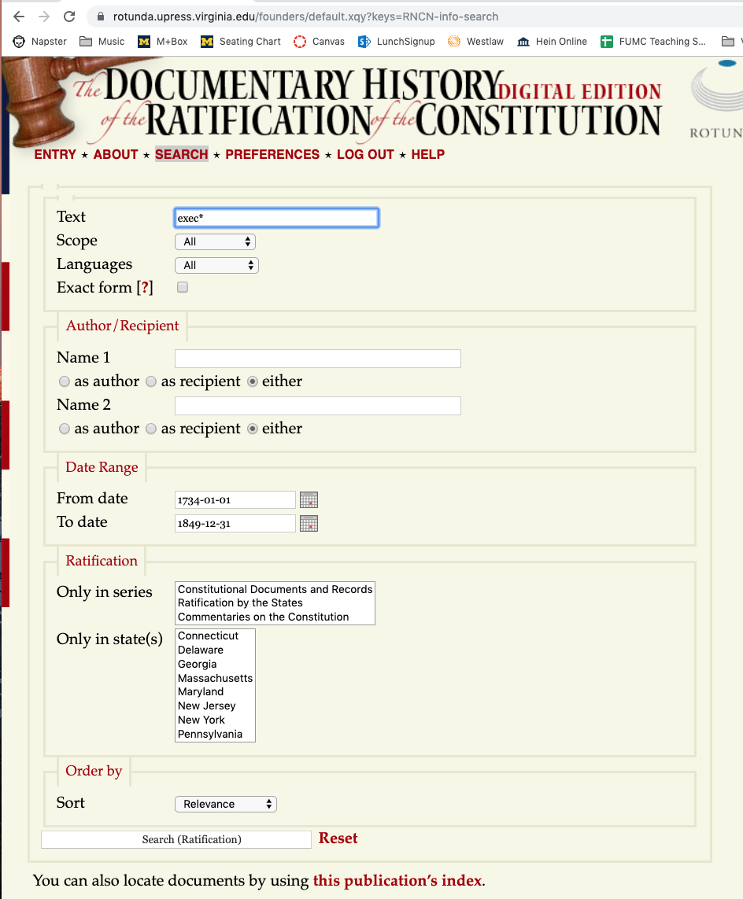

Slide 14
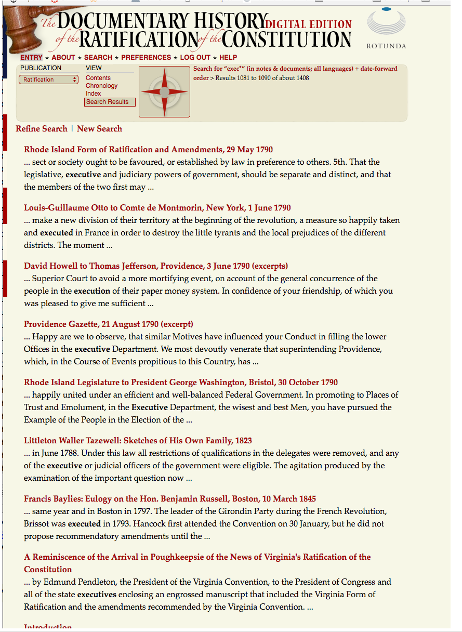

Slide 15
